Slide 1


FINC 5130 - FINANCIAL MODELING
SALES REPRESENTATIVES SALARIES PREDICTION
REGRESSION ANALYSIS
PRESENTED BY TEAM 4:
VELANGINI ROJA KARANAM
SRI LAKSHMI MALLIPUDI
KARAN SAVALIYA
JINNY BATJARGAL
JUSTIN LE
AMI SHAH

Slide 2

CONTENT
01
INTRODUCTION
02
DATASET OVERVIEW
03
EXPLORATORY DATA ANALYSIS (EDA)
04
FEATURE ENGINEERING
05
MODEL EVALUATION
06
MODEL INTERPRETATION
07
RECOMMENDATIONS

Slide 3



INTRODUCTION
In today’s competitive business landscape, retaining top sales talent is crucial. Designing compensation structures that recognize performance while adhering to industry norms and individual traits is essential for effective talent management.
Our analysis endeavors to identify critical factors influencing salary and build an accurate regression model tailored to both the software and hardware industries. By doing so, we aim to offer actionable insights to organizations, enabling them to make informed decisions and uphold equitable and competitive compensation structures for sales representatives.

Slide 4





DATASET OVERVIEW
Variables
Shape
Data types
Target: Salary
Features:
Sales_Rep
Business
Age
Female
Years
College
Personality
Certificates
Feedback
NPS
Records: 21,990 | Attributes: 11
Each record corresponds to a Sales Representative’s profile, identified by unique ID
The dataset has a mix of datatypes, including
String: Business, College, Personality
Integer: Sales_Rep, Age, Female, Years, Certificates, NPS & Salary
Float: Feedback
Note: There are no missing values in the dataset

Slide 5

EXPLORATORY DATA ANALYSIS (EDA)

Slide 6
DESCRIPTIVE STATISTICS
Variable | Count | Mean | Std Dev | Min | 25% | Median | 75% | Max
Age | 21,990 | 41.50 | 11.41 | 21.00 | 32.00 | 41.00 | 51.00 | 65.00
Years | 21,990 | 2.65 | 2.43 | 1.00 | 1.00 | 2.00 | 2.00 | 13.00
Certificates | 21,990 | 2.61 | 1.65 | 0.00 | 1.00 | 2.00 | 4.00 | 6.00
Feedback | 21,990 | 2.66 | 0.84 | 1.08 | 1.99 | 2.66 | 3.39 | 4.00
Salary | 21,990 | 73,673 | 22,769 | 21,000 | 57,000 | 70,000 | 87,000 | 1,97,000
NPS | 21,990 | 6.28 | 2.16 | 1.00 | 5.00 | 6.00 | 8.00 | 10.00

Slide 7
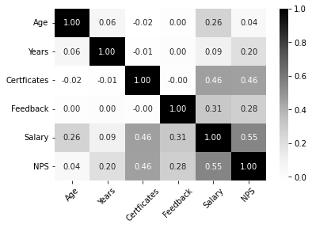
CORRELATION ANALYSIS
Observations:
Among the independent variables, only NPS and Certificates exhibit a moderate relationship with the dependent variable, Salary.
However, there appears to be no strong positive or negative relationship with the Salary for the other variables.

Slide 8
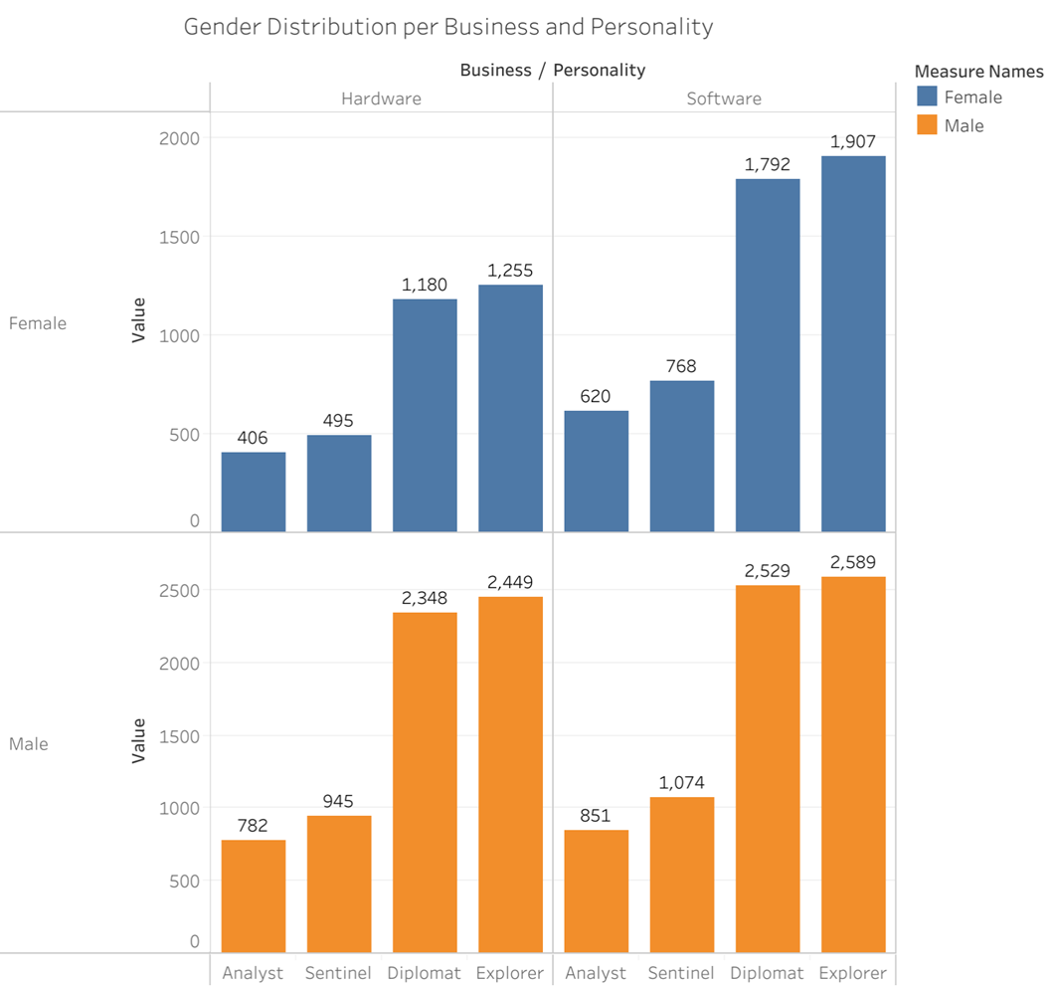
EDA INSIGHTS

Slide 9
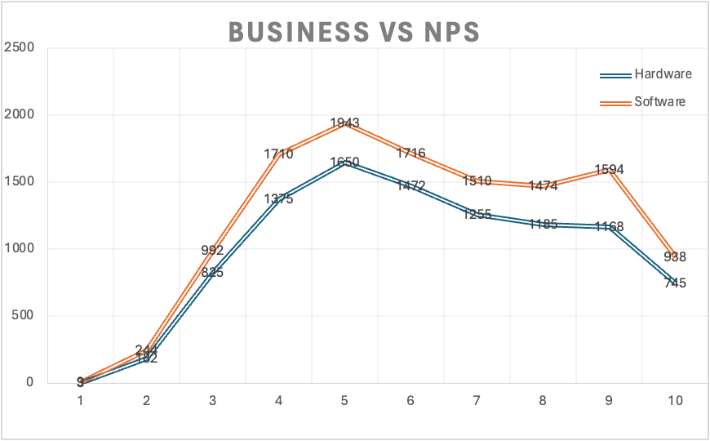
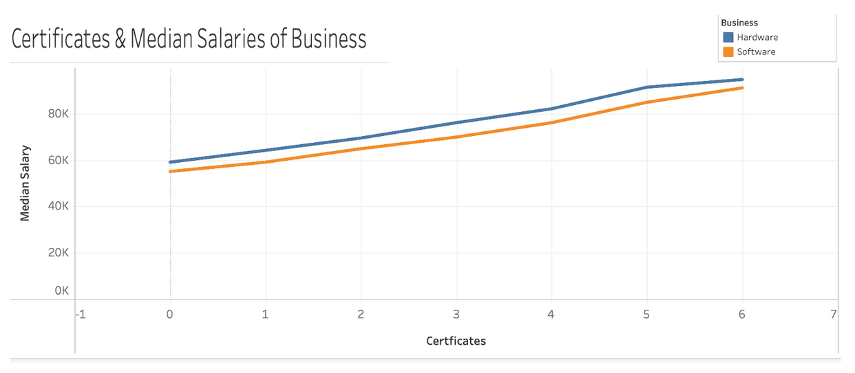

Slide 10
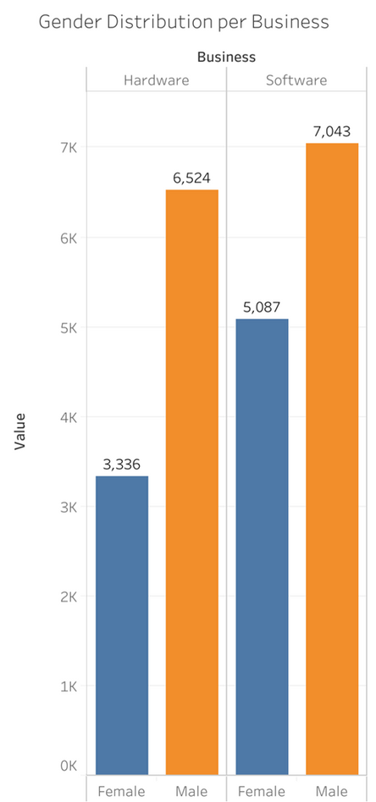
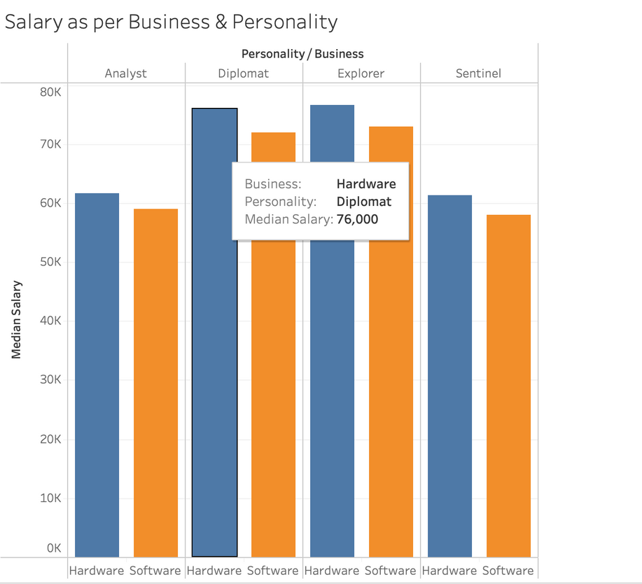

Slide 11

FEATURE ENGINEERING
Cre
Employed MinMax technique to scale features to a range of 0 to 1, ensuring uniformity in feature scales.
Prevents dominance of any single feature due to larger scales.
Converted Categorical variables into binary dummy variables.
Dropped the first level of each categorical variable, known as the reference category, to avoid multicollinearity.
Partitioned the data into training (80%) and testing (20%) subsets.
This process allows us to evaluate the model’s performance on unseen data, assessing generalization capabilities for real-world applications
Creation of Dummies
Normalization
Train-Test-Split
Note: Removed Sales_Rep as it is a unique identifier; not predictive of salary.

Slide 12
MODEL EVALUATION

Slide 13
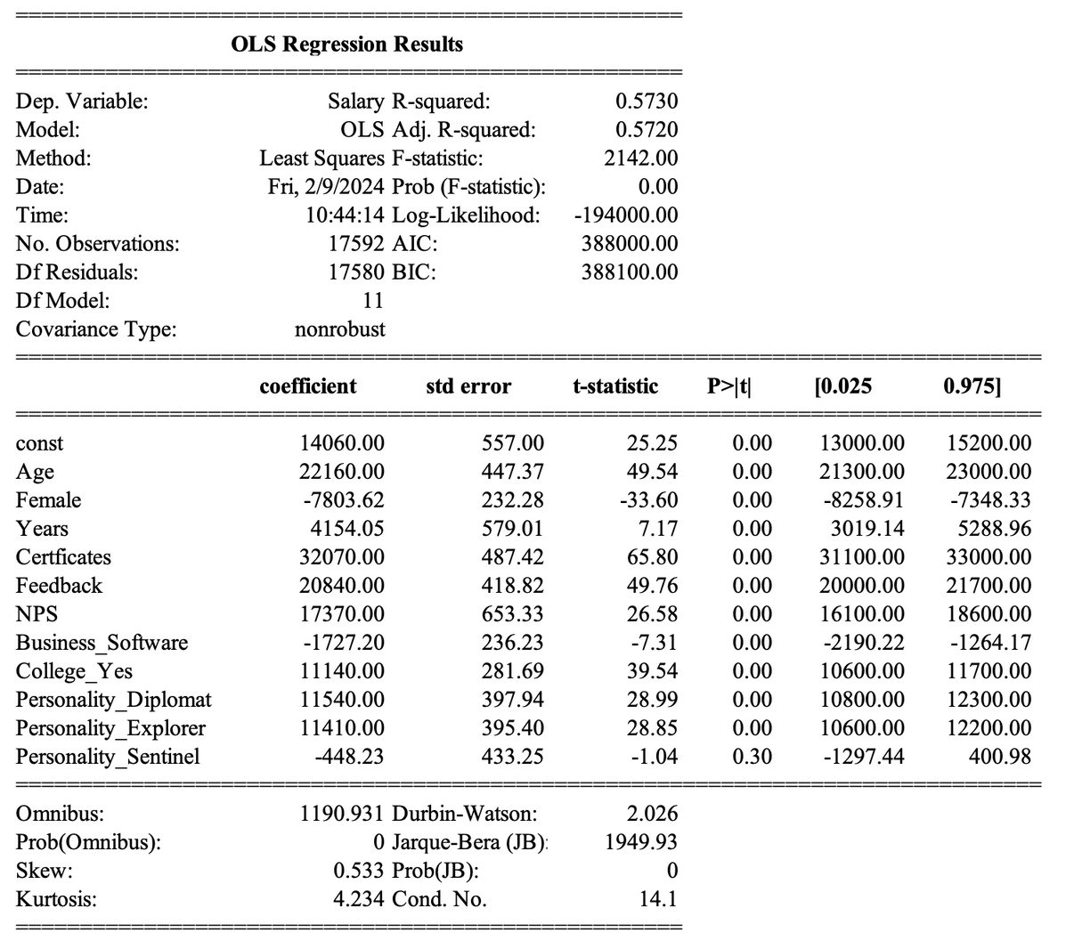
INITIAL MODEL RESULTS
Observations:
Model R-squared: 0.573
No Multicollinearity: Variance Inflation Factor (VIF) scores are below 5 for all variables, indicating no significant multicollinearity issues among predictor variables.
Statistical Significance: All variables, except Personality_Sentinel, are statistically significant (p-value < 0.05) in predicting salary.
Drop Insignificant feature: Removed the Personality_Sentinel variable and rebuild the model.

Slide 14
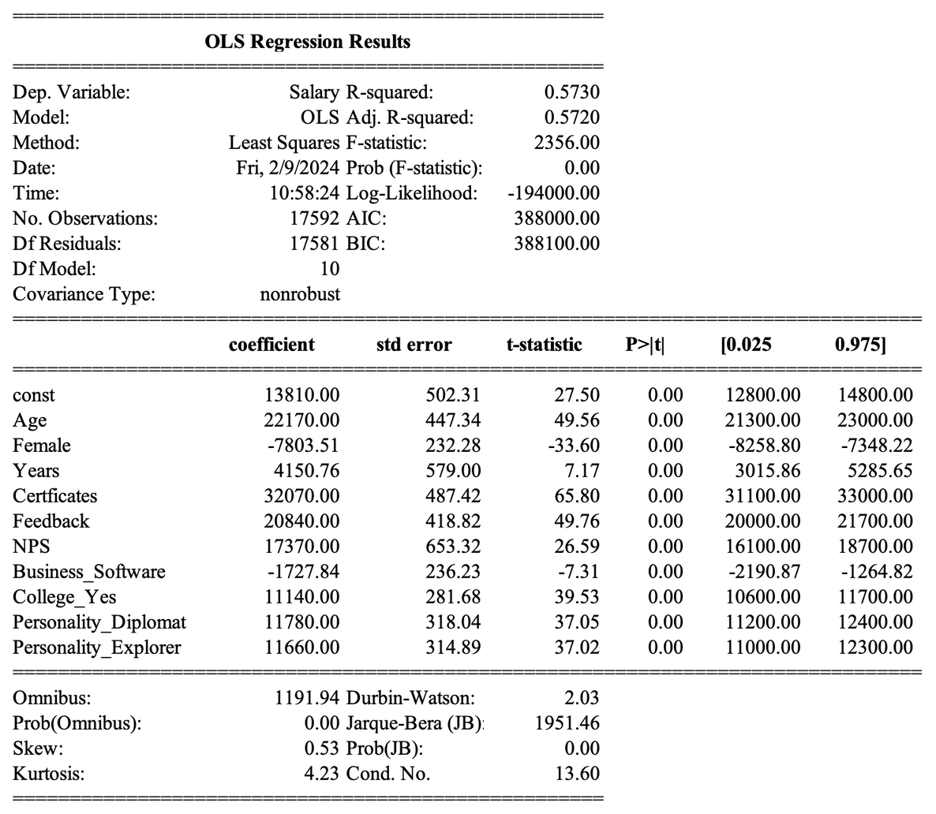
REVISED MODEL RESULTS (DROPPING SENTINEL PERSONALITY)
Observations:
Model R-squared: Despite dropping Sentinel Personality, R2 value remains at 0.573, suggesting that this variable didn’t contribute meaningfully to the model’s predictive power.
No Multicollinearity: Variance Inflation Factor (VIF) scores are below 5 for all variables, indicating no significant multicollinearity issues among predictor variables.
Statistical Significance: All variables are statistically significant (p-value < 0.05) in predicting salary.

Slide 15

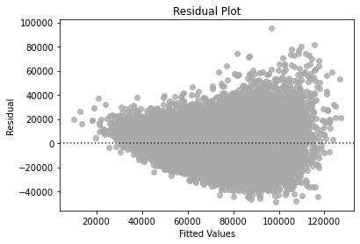
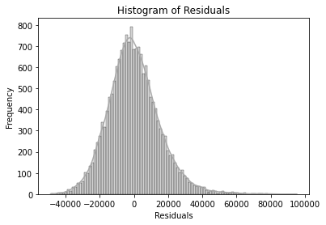
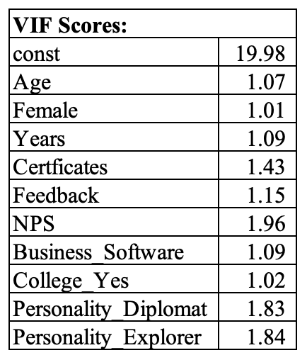
LINEAR REGRESSION ASSUMPTIONS
01
02
03
04
NORMALITY
HOMOSCEDASTICITY
NO MULTICOLLINEARITY
LINEARITY
Goldfeld-Quandt test
Null hypothesis: Residuals are homoscedastic
Alternate hypothesis: Residuals are heteroscedastic
Results:
F Statistic: 1.0131
P-value: 0.2709
Since the p-value is> 0.05, we fail to reject the null hypothesis. Hence, residuals are homoscedastic.
Variance Inflation Factor (VIF) scores are below 5
Normal distribution of residuals.
Identified non-random distribution pattern, indicating violation of linearity assumption.
Solution: Apply log transformation on the target variable and retrain the model to address this issue.
Mean of Residuals: -0.000000000012, close to zero.

Slide 16
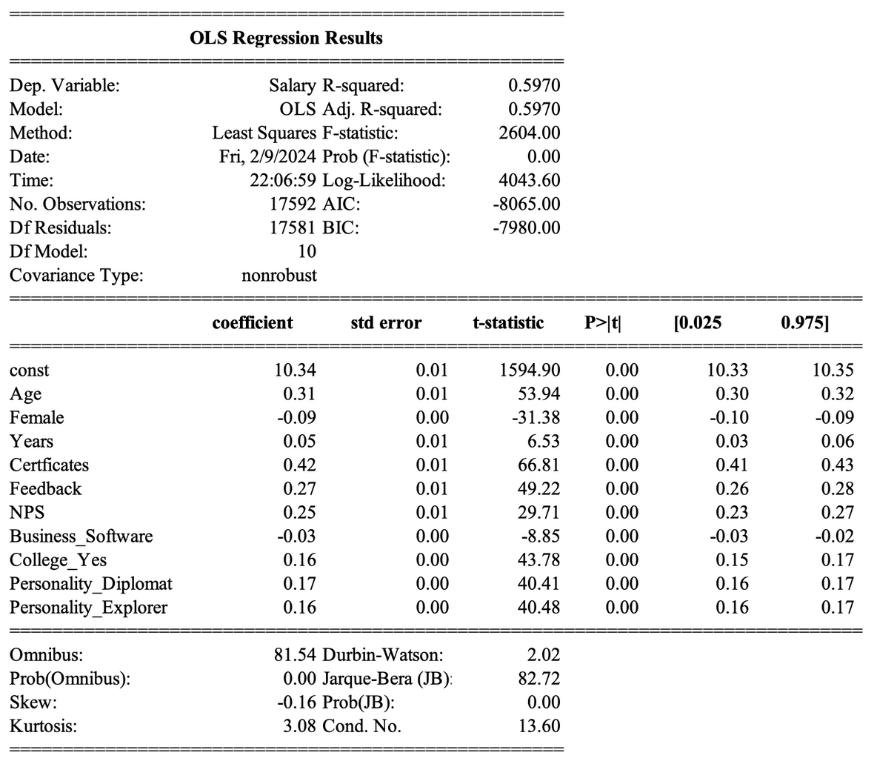
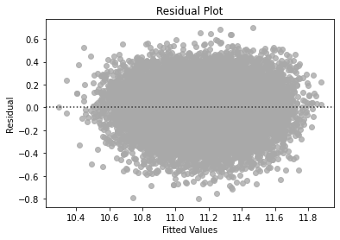
FINAL MODEL RESULTS (AFTER LOG TRANSFORMATION)
Observations:
Residuals exhibit no discernible pattern, confirming satisfaction of the Linearity assumption.
All assumptions of the linear regression model are satisfied
Model performance has improved, with R-squared increasing from 0.57 to 0.60.

Slide 17

EVALUATION METRICS
01
02
03
R-SQUARED
MEAN SQUARE ERROR
ROOT MEAN SQUARE ERROR
Our model achieves an R-squared value of 0.5970, indicating that approx. 60% of the variance in the Salary is explained by the independent variables.
Our model’s MSE is 0.0369, suggesting that, on average, the squared difference between predicted and actual values is approx. 0.037.
Our model’s RMSE is approx. 0.1923 indicates minimal differences b/w predicted and actual salaries, reflecting a high level of prediction accuracy.
R-Squared: 0.596
Model Fitness:
Cross-validation scores closely match training dataset metrics, suggesting that our model is well-fitted with generalized performance.
CROSS-VALIDATION SCORES
MSE: 0.037

Slide 18
MODEL INTERPRETATION
MODEL EQUATION
Log(Salary) = 10.34 + 0.31 * Age - 0.09 * Female + 0.05 * Years + 0.42 * Certificates + 0.27 * Feedback + 0.25 * NPS - 0.03 * Business_Software + 0.16 * College_Yes + 0.17 * Personality_Diplomat + 0.16 * Personality_Explorer
Positive Predictors
Holding all other variables constant,
Age (0.31): Older employees tend to have higher salaries
Years (0.05): Increased experience leads to higher salaries
Certificates (0.42): Possession of professional certificates leads to higher salaries
Feedback (0.27): Positive performance feedback corresponds to higher salaries
NPS (0.25): Higher Net Promoter Scores(NPS) is associated with increased salaries
College_Yes (0.16): Holding a college degree leads to higher salaries
Personality Traits (Diplomat/Explorer) (0.17/0.16): Employees with diplomatic or explorative personality traits earn higher salaries than those with Sentinel and Analyst personalities.
Negative Predictors
Holding all other variables constant,
Female (-0.09): Female employees earn lower salaries compared to males
Business Software (-0.03): Sales representatives in the Software industry earn lower salaries compared to their counterparts in the Hardware industry

Slide 19
RECOMMENDATIONS
Experience-Driven Compensation: Prioritize Salary adjustments based on experience while supporting continuous learning through educational programs and certifications to maintain a skilled workforce.
Recognize Performance: Implement regular performance evaluations and feedback mechanisms to effectively reward employee contributions effectively, fostering a culture of appreciation and motivation.
Promote Gender Equality: Ensure equal pay for equal work and cultivate an inclusive workplace culture that values and respects all employees, regardless of gender, through gender diversity initiatives.
Personality Trait-Based Salary: Tailor compensation frameworks to reflect the impact of personality traits, with a focus on prioritizing traits such as diplomacy and exploration.
Enhance Employee Satisfaction: Improve workplace conditions, offer growth opportunities, and foster a supportive environment to boost employee satisfaction and engagement.

Slide 20



THANK YOU
DO YOU HAVE ANY QUESTIONS ?

